Slide 1
Three Sample BIBFRAME Records
Yoel Kortick
Yoel.Kortick@clarivate.com

Slide 2
Agenda
  The Work and the Instance (with real examples)
  Sample record number one
  Sample record number two
  Sample record number three

Slide 3
The Work and the Instance (with real examples)

Slide 4
The Work and the Instance (with real examples)
We will now focus on situations where:
  There is one work with multiple instances
  There are multiple works, each with its own instance
Let’s again look at the definitions of a Work and an Instance to understand this better.
Work = The highest level of abstraction, a Work, in the BIBFRAME context, reflects the conceptual essence of the cataloged resource: authors, languages, and what it is about (subjects).
Instance = A Work may have one or more individual, material embodiments, for example, a particular published form. These are Instances of the Work. An Instance reflects information such as its publisher, place and date of publication, and format.

Slide 5
Sample record number one

Slide 6
Sample record number one
Title “The feminine mystique” by author “Friedan, Betty” was published twice in New York in physical form by publisher W.W. Norton: in 1997 and in 2013
  Publication 1: New York W.W. Norton c1997 (ISBN 9780393322576) (LCCN 2001044231)
  Publication 2: New York W.W. Norton c2013 (ISBN 9780393934656) (LCCN 2012018760)

Slide 7
Sample record number one
There will be one work and two instances.
There will be one work because there is one “highest level of abstraction”. The 1997 and 2013 publications differ only in the year published (as well as the ISBN, LCCN, a few other details).
The intellectual creation is fundamentally the same. The author, language, subjects, etc. are the same for both publications, and thus there is one work.
There are two instances to represent each of the specific publications.

Slide 8
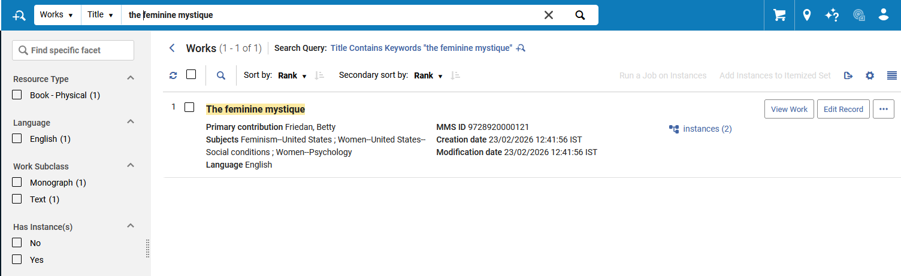
Sample record number one
One work with two instances. Here we are retrieving the Works.
Searching the Works
One Work with two Instances

Slide 9
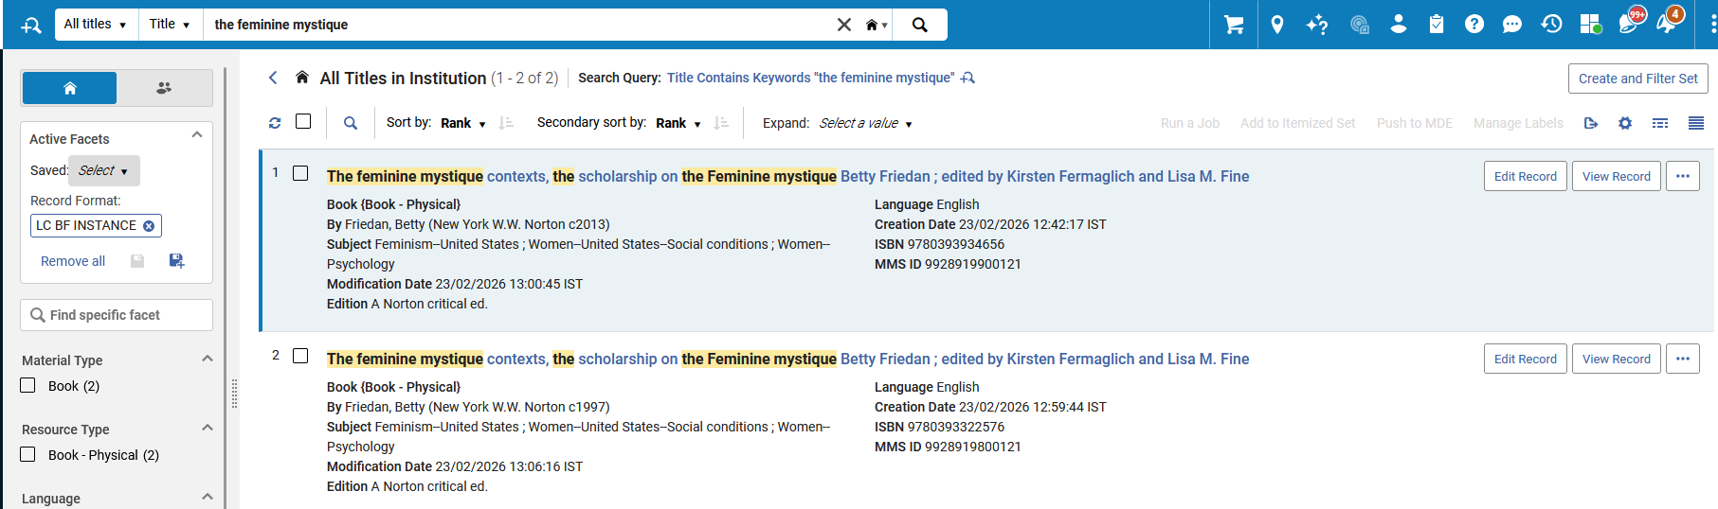
Sample record number one
Two separate instances each for the same work. Here we are retrieving the Instances.
Searching the Instances
This is the instance of the 2013 edition.
This is the instance of the 1997 edition.

Slide 10
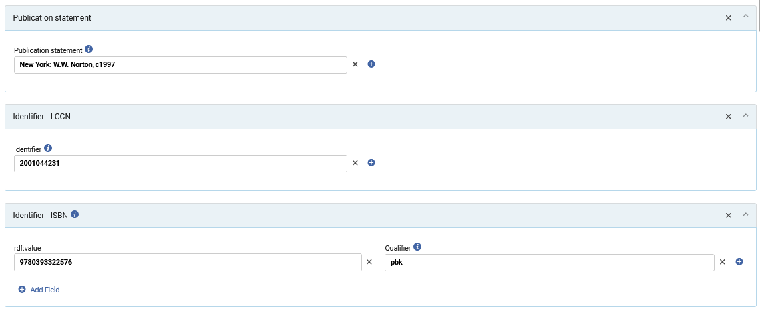
Sample record number one
Here is the Publication statement, LCCN and ISBN as part of the Instance of the 1997 Instance

Slide 11
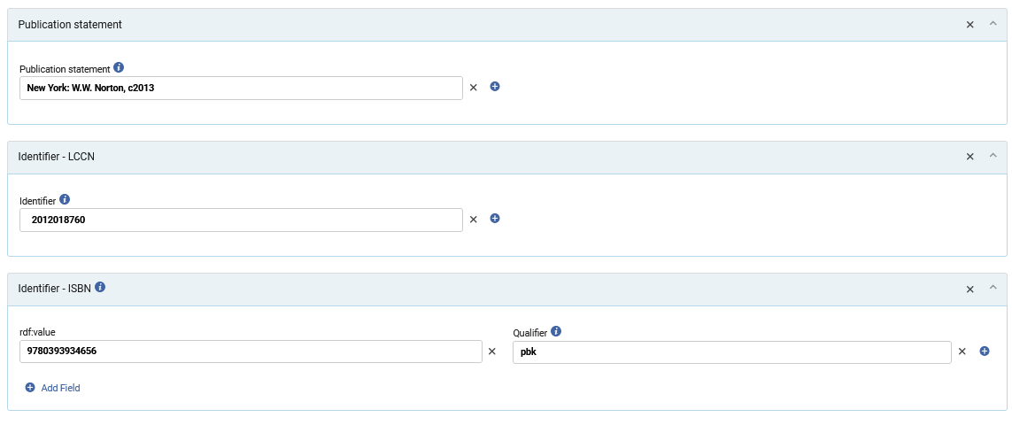
Sample record number one
Here is the Publication statement, LCCN and ISBN as part of the Instance of the 2013 Instance

Slide 12
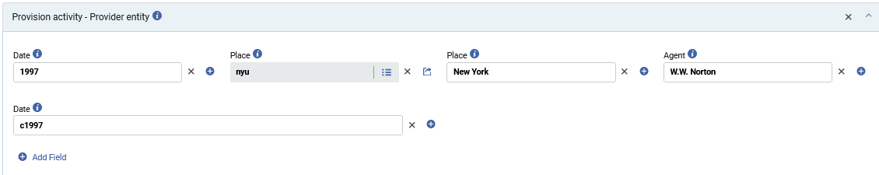
Sample record number one
Here is the “Provision activity - Provider entity” part of the Instance of the 1997 Instance

Slide 13
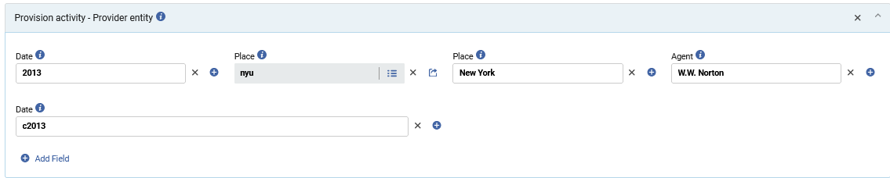
Sample record number one
Here is the “Provision activity - Provider entity” part of the Instance of the 2013 Instance

Slide 14
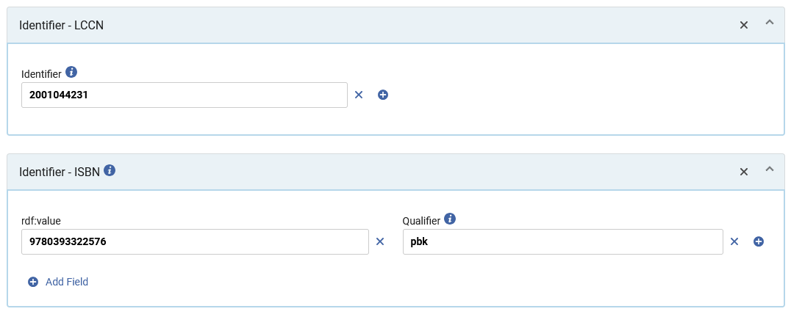
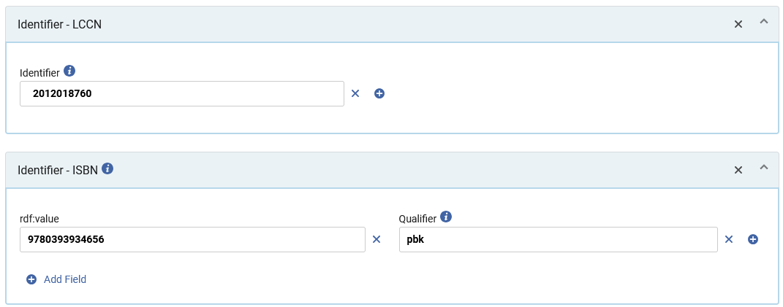
Sample record number one
The LCCNs and ISBNs also differ among the two instances.
The instance of the 1997 edition
The instance of the 2013 edition

Slide 15
Sample record number one
The ISBNs also differ among the two instances. Here is the 2013 instance

Slide 16
Sample record number two

Slide 17
Sample record number two
Title “Jane Eyre” by author “Charlotte Brontë” was published twice, once in physical form and once as an audio recording:
  Publication 1: Audio Edition. [Venice, Calif.] L.A. Theatre Works p2016
  Publication 2: Physical edition. Oxford [Eng.] Clarendon Press 1975, c1969

Slide 18
Sample record number two
  The 2016 audio edition is
  A dramatized or other adaptation (for example with multiple actors, sound effects, and adapted script
  Not a straight narration of the novel
  Therefore, it is a related but separate Work
  The related but separate Work is an audio drama related to (or based on) the novel, and not merely an audio format of the novel itself.
  Hence there are two Works:
  The work with the instance of the 1975 physical edition
  The work with the instance of the 2016 dramatized adaptation audio edition

Slide 19
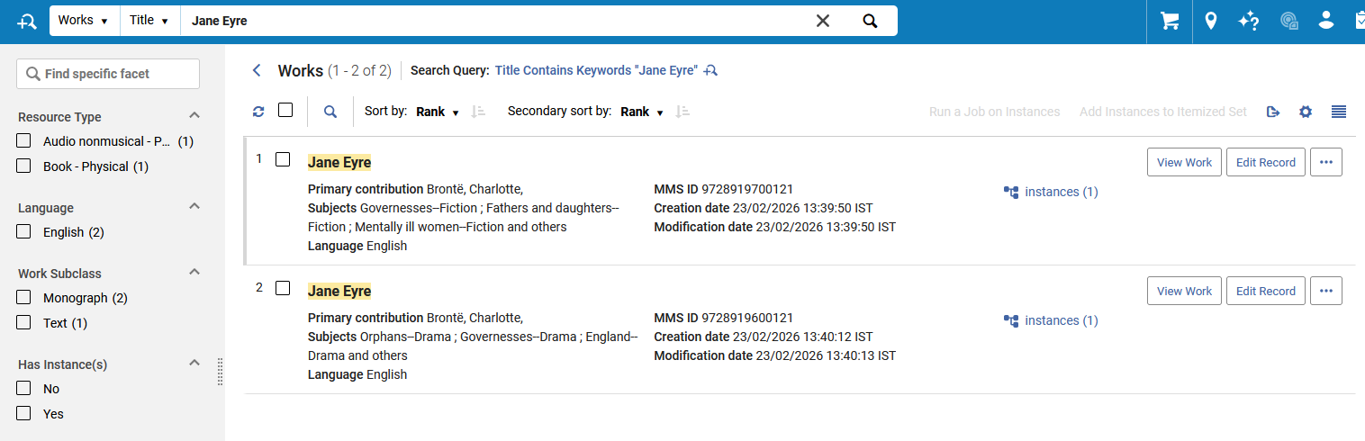
Sample record number two
There are two separate works, each with its own instance. Here we are retrieving the Works.
Searching the Works
Each Work has its own instance

Slide 20
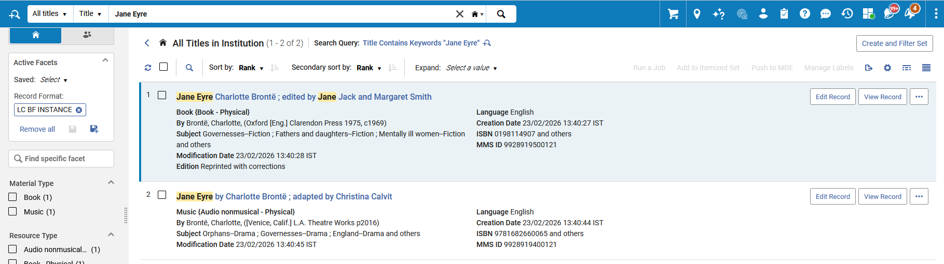
Sample record number two
There are two separate works, each with its own instance. Here we are retrieving the Instances
Searching the Instances
This is the physical book
This is the audio book

Slide 21
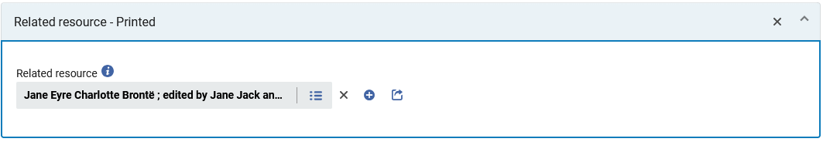
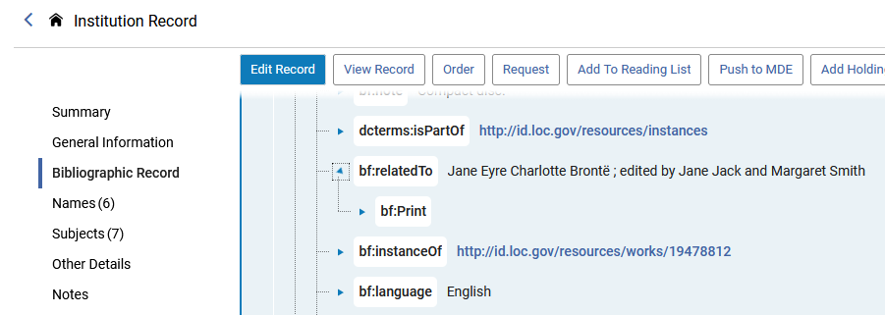
Sample record number two
The instance of the audio book is related to the instance of the printed book

Slide 22
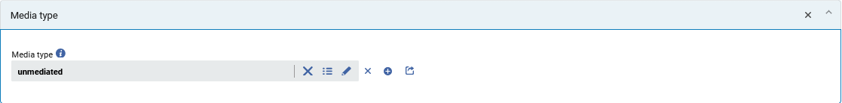
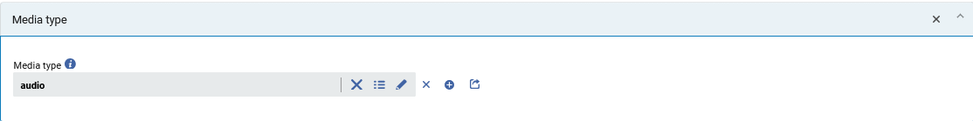
Sample record number two
The instance of the physical book and the instance of the audio book each have the relevant media type
Instance of the physical book
Instance of the audio book

Slide 23
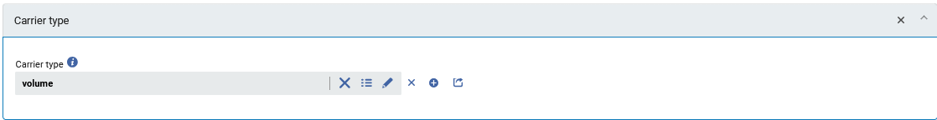
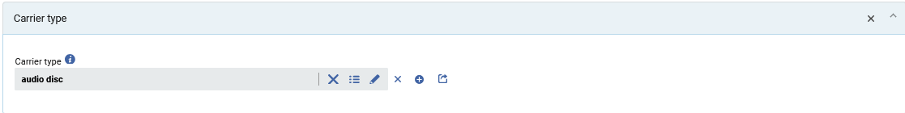
Sample record number two
The instance of the physical book and the instance of the audio book each have the relevant carrier type
Instance of the physical book
Instance of the audio book

Slide 24
Sample record number three

Slide 25
Sample record number three
Title “Woman in the nineteenth century, and kindred papers relating to the sphere, condition and duties, of woman” by author “Fuller, Margaret” was published in 1855 in Boston by J.P. Jewett and company
The electronic version of this 1855 Boston publication appears at https://www.gutenberg.org/cache/epub/8642/pg8642.txt

Slide 26
Sample record number three
There will be one work and two instances.
There will be one work because there is one “highest level of abstraction”.
The intellectual creation is fundamentally the same.
  The author, language, subjects, etc. are the same for both publications, and thus there is one work.
The only properties that differ in the Instances is the “Media Type” and “Carrier Type”.
The two Instances will be as follows:
  Instance 1: The physical book on the shelf
  Instance 2: The electronic book at https://www.gutenberg.org/cache/epub/8642/pg8642.txt

Slide 27
Sample record number three
The two instances represent each of the specific media types and carrier types.
The electronic book will have:
  Media Type: computer (mediaTypes/c)
  Carrier Type: online resource (carriers/cr)
The physical book will have:
  Media Type: unmediated (mediaTypes/n)
  Carrier Type: volume (carriers/nc)

Slide 28
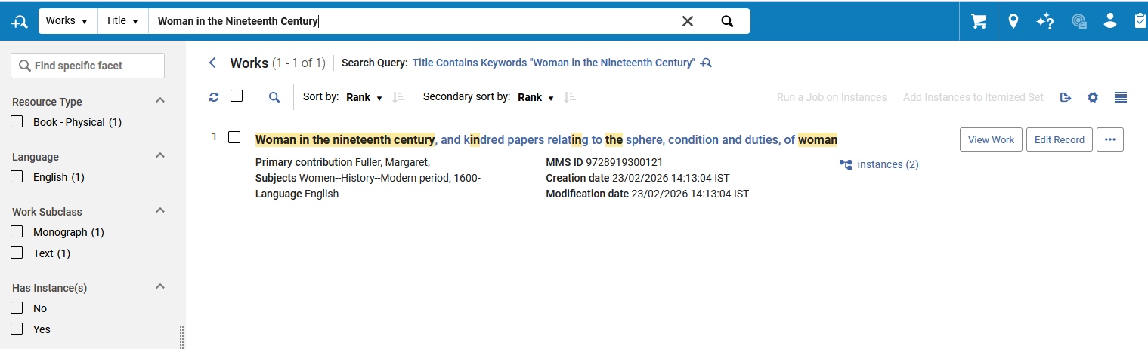
Sample record number three
One work with two instances. Here we are retrieving the Works.
Searching the Works
One Work with two Instances

Slide 29
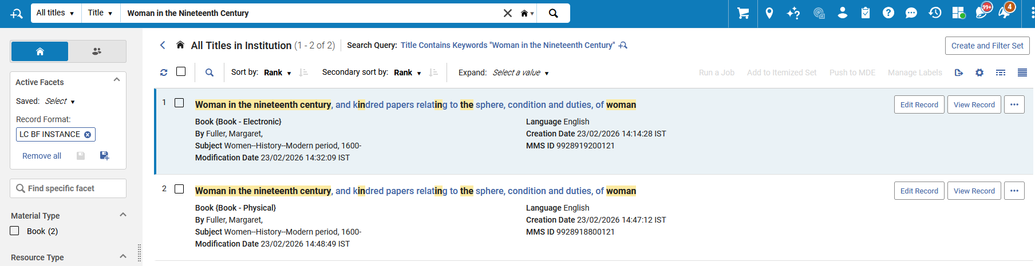
Sample record number three
Two separate instances each for the same work. Here we are retrieving the Instances.
Searching the Instances
This is the instance of the electronic book.
This is the instance of the physical book.

Slide 30
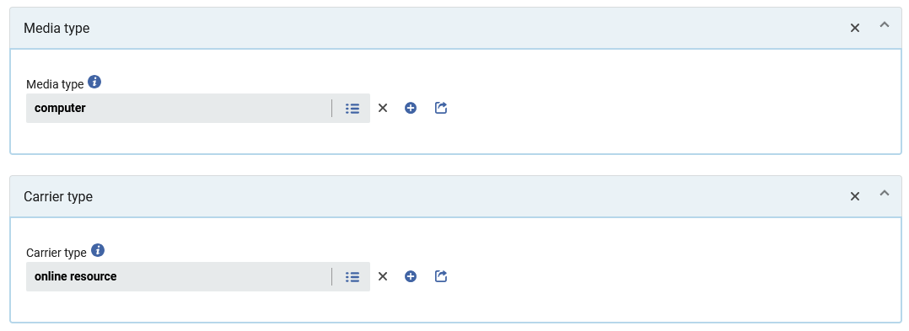
Sample record number three
This is the instance of the electronic book.

Slide 31
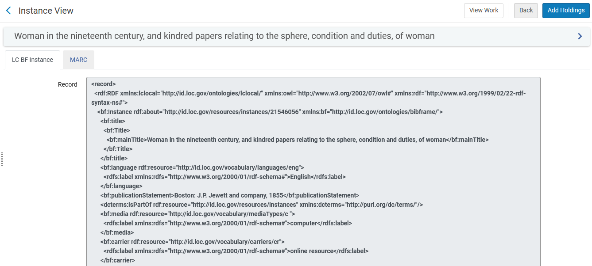
Sample record number three
This is the instance of the electronic book.

Slide 32
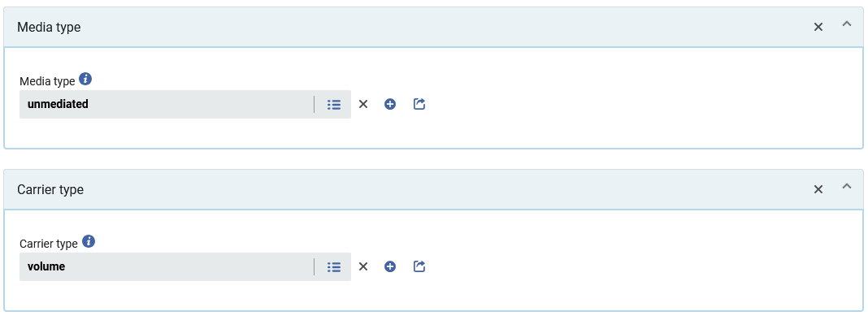
Sample record number three
This is the instance of the physical book.

Slide 33
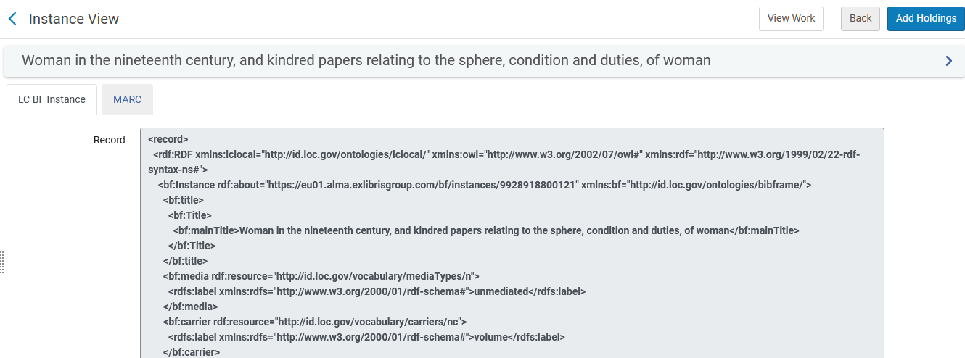
Sample record number three
This is the instance of the physical book.

Slide 34


Yoel Kortick
Yoel.Kortick@clarivate.com
About Clarivate
Clarivate is a leading global provider of transformative intelligence. We offer enriched data,
insights & analytics, workflow solutions and expert services in the areas of Academia & Government, Intellectual Property and Life Sciences & Healthcare. For more information, please visit clarivate.com.
© 2026 Clarivate. All rights reserved
Clarivate and its logo, as well as all other trademarks used herein are trademarks of their respective owners and used under license.

